Slide 1

LSTMusic: A Web-Based AI Melody Extension Tool.
Thomas Dent, Candidate #246518
Final Year Project (G5038)
13.05.2024
Notes:
Hello! I would like to present a brief overview of the design and development of my final year project, LSTMusic.
I’d just like to note that I would like any questions to be asked towards the end of the presentation.

Slide 2
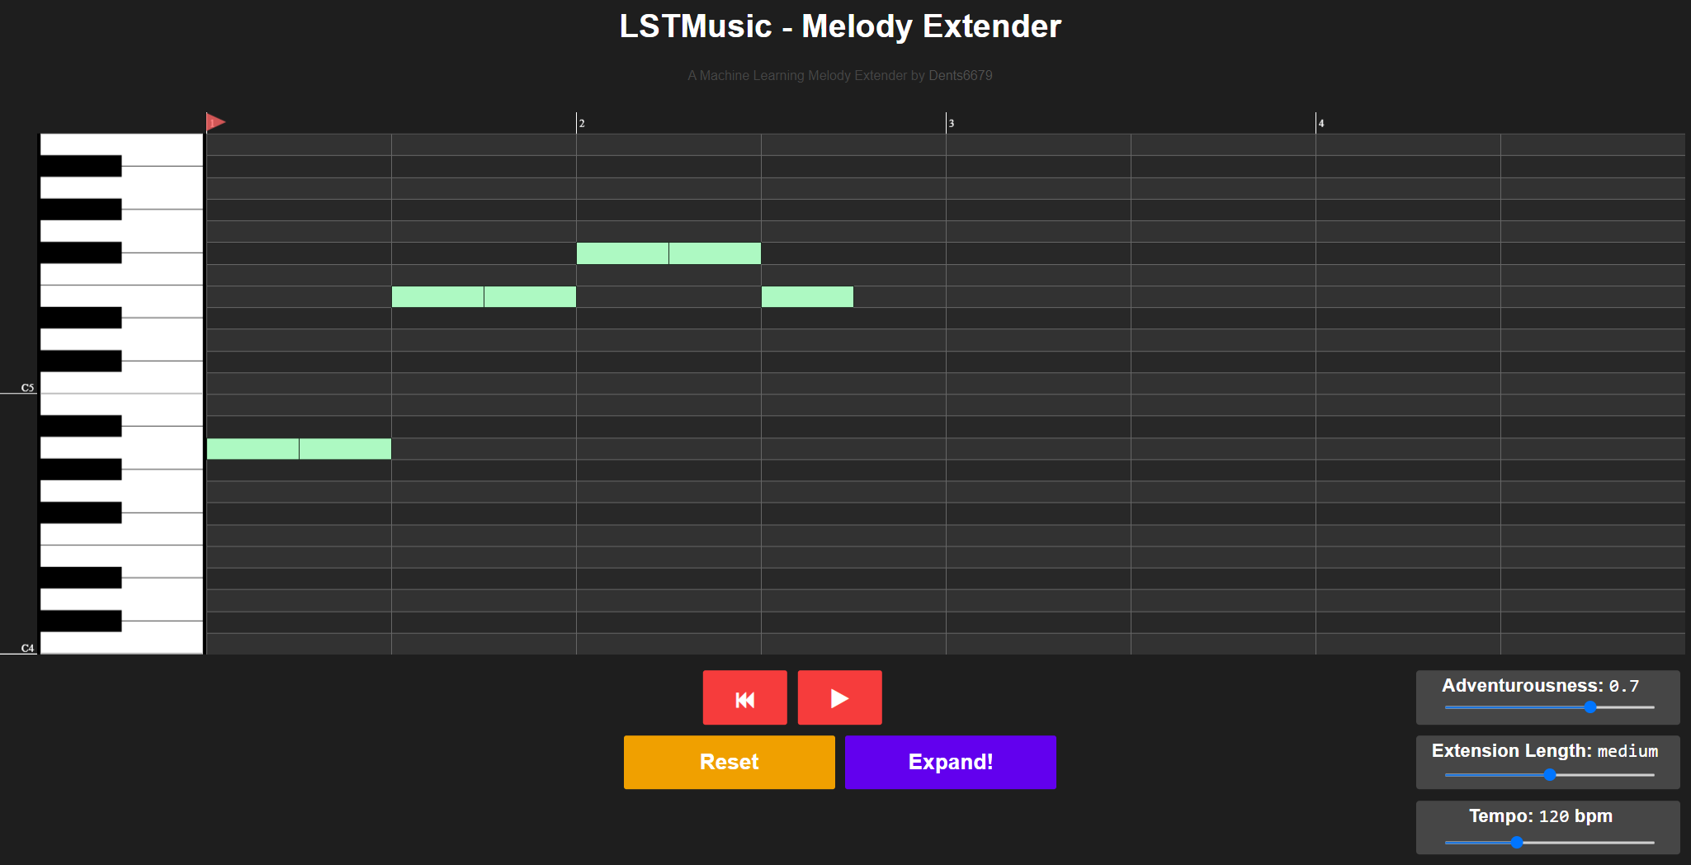
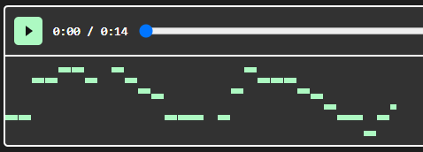
What is LSTMusic?
An AI Web Tool / Toy
Allows for easy experimentation with generative AI in music.
Accessible to anyone via https://Dents6679.github.io/LSTMusic
User Input
Generated Notes
Notes:
LSTMusic is a web-based melody extension tool that I’ve made over the duration of third year, that uses an LSTM Neural Network to generatively extend user supplied melodies. It’s built with the purpose of allowing users to essentially `toy around’ with AI music generation in a similar way to how sites like Dall-E and ChatGPT allow people to experiment with complex generative models in very easy-to-use interfaces, typically through websites.
It is built with simplicity in mind and aims to not require any musical knowledge or technical experience.

Slide 3
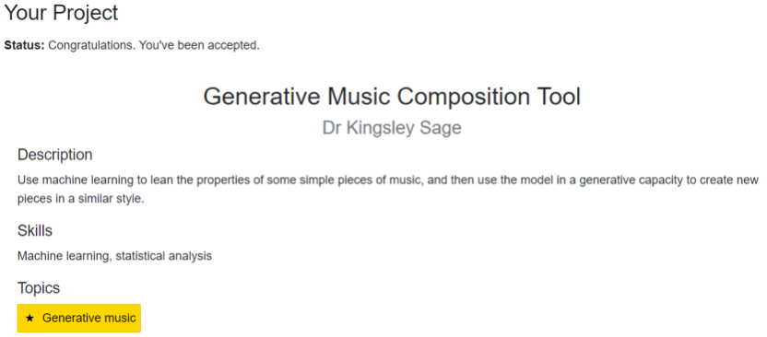
Project Motivation & Inspiration
What to do
Figuring out what I wanted to do was difficult to begin with.
Create a generative music plugin for music production software?
Research the best music generation Technique?
Many other options!
Let’s just see what’s out there first…
Notes:
So, to begin I’d like to quickly touch upon how I ended up shaping the project in the way I did.
Towards the start of the year, around September, October, I really didn’t have a clue of what I was going to do for this project
Looking at the brief, its scope was quite broad and gave a nice amount of project flexibility but it made it very difficult to decide what MY project was about.
So instead of diving head-first into building the first thing I thought of, I decided why don’t I look around to see what others have done in generative music?
This led me into my background research phase where I discovered a few different generative music projects from some big-name companies like OpenAI, Meta and Microsoft, but one project in particular really stood out to me, which was Magenta Studio, by Google’s Magenta research team.

Slide 4
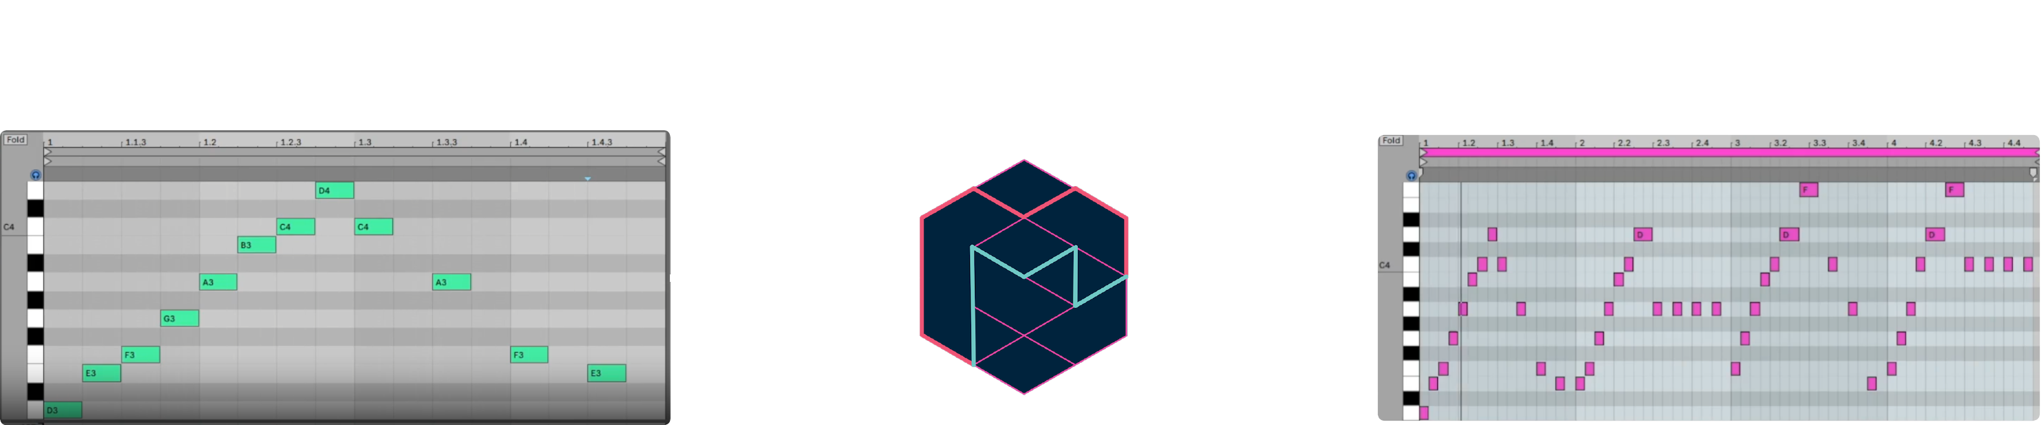
Magenta Studio
Project Motivation & Inspiration
Magenta Studio – Five music Generation tools for Ableton Live.
Continue stood out, allowing user input to be extended using ML techniques.
But… magenta is a slight pain to use
1. Download and Install Ableton Live…
2. Figure out how Ableton Live works…
3. Download and install Magenta Studio…
4. Finally use it…
It doesn’t need to be this difficult!
Notes:
Magenta Studio It is a set of 5 AI powered music composition tools for Ableton Live, which is a professional music production software package. For the sake of this project, I wanted to only focus on magenta `continue’ tool, which generatively expands melodies that users can input through a piano roll.
Continue is pretty much the main inspiration for this project, and stood out to me as it had a quite novel aspect of direct user influence that the other tools in magenta studio didn’t have.
It very impressively expands user provided melodies, but I found the process of actually setting up Ableton Live and the hurdles of understanding how It worked slightly frustrating.
And this frustration is what ended up with me realising what I wanted my project to be.

Slide 5
Project Objective
Create an AI Melody Extender, like Magenta Studio’s Continue tool.
Eliminate the burden of confusion and frustration that I felt while setting up Magenta Studio.
Build myself a foundation of web development experience.
Basic Frontend development
Backend API development
Hosting web content
Notes:
That being, a melody extension system like Continue, but without the difficulties associated with installing and learning software packages.
I decided that I would to build this system as a website, which served a bit of a dual purpose as it would make the tool very accessible, but would also be a way to introduce myself to the basics of web development and the challenges associated with it, which was a personal goal of mine that I wanted to complete for a while.

Slide 6

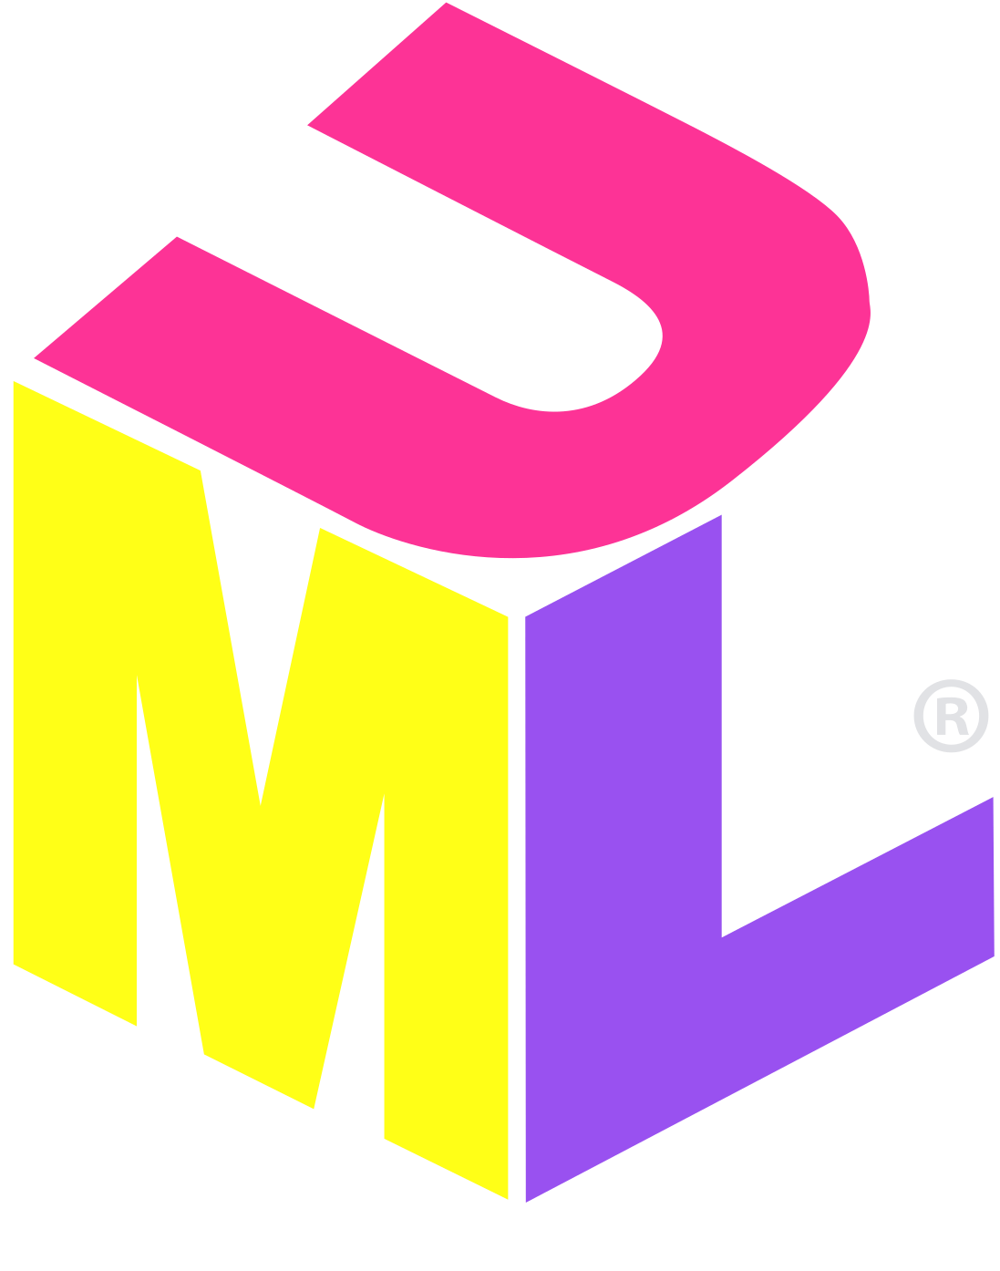




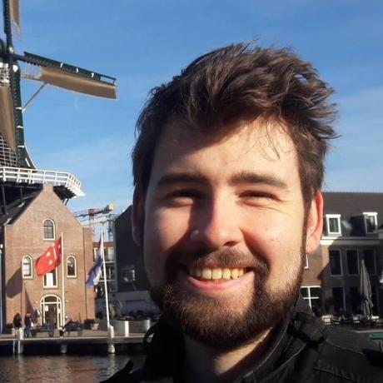


Design & Development
Design Strategy: Make high-level UML & UI Designs, worry about low level details during development.
Agile-like Iterative Development with four main phases.
Creating the first frontend prototype.
Creating a generation model and surrounding API.
Rewriting and improving the frontend, as my first attempt was not fit for purpose.
Getting everything Hosted online.
Notes:
After this objective was realised, I began on actually designing and developing the system.
This was done in a bit of an agile manner, with phases of design being followed by a long period of development over four sprint-like phases,
One for the project’s frontend,
One for the project’s backend
One for an improved frontend
And one to get everything hosted.

Slide 7

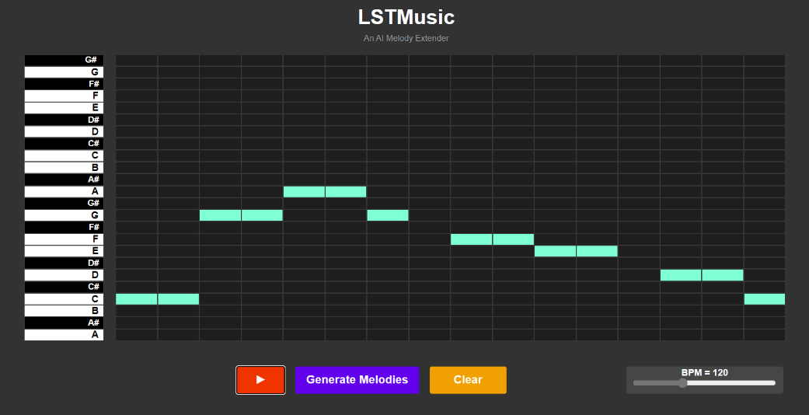
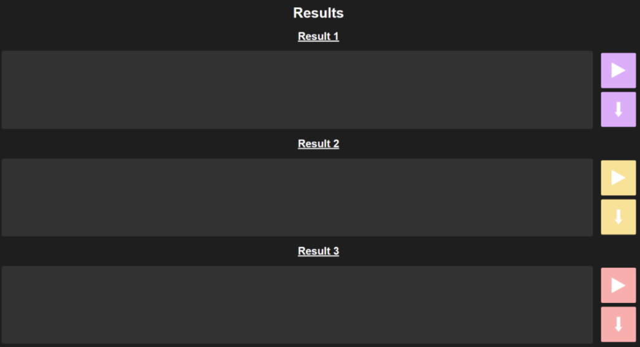

Frontend Prototype 1
Adapted from a minesweeper tutorial’s grid.
Required lots of trial and error, I never touched JS/HTML/CSS before this
3 pages to complete identified use cases.
Left with skeletal elements due a lack of backend.
Looking back, this implementation was extremely bodged.
Notes:
So, I decided to begin by prioritising getting a first frontend prototype completed. I needed to quite quickly familiarise myself with HTML, CSS and Javascript as i never used any of these languages before.
I decided to use just a vanilla stack without any additional web frameworks, as I was pretty much just looking to understand the basics, and didn’t want to add any unnecessary complexity.
Planning at this point only involved making quite high level use case diagrams and UI designs and to kind of formalise what I wanted any users to be able to do.
There was very little low level planning at this stage, as I didn’t really know enough about web to effectively plan anything more in depth than use case diagrams.
Sadly this did result in some pretty horrendous spaghetti code, which I had to replace in my second frontend prototype.
The results of my efforts are along the bottom, with an interactive page, waiting page and skeletal results page being made.
At this point, I naively assumed that the frontend was complete enough to allow for unrestricted backend development, which prompted me to begin my second sprint to make the backend.
(Moved over to backend development)

Slide 8

Backend
Extension Model adapted from Valerio Velardo’s RNN-LSTM for music generation.
3 API Endpoints to complete frontend’s use cases:
  Request melody extension.
  Check extension status.
  Retrieve extended melody.
Planned with modularity in mind for model swapping later.
Notes:
The project’s backend, was built and designed around two main components:
An LSTM based melody extension system, which was adapted from a very helpful resource provided by a man named Valerio Velardo,
And a surrounding API, designed to enable the communication between this model and the frontend.
I decided to use Python and Flask for this backend as I’m very familiar with Python, and Flask seemed to be a good lightweight web framework with decent documentation.
Planning for this phase was thankfully a bit more in depth as I was able to plan the lower level parts of how the API would interact with my frontend through some more thorough sequence diagrams.
At this stage I also made quite an effort to make sure that the backend was modular, putting all of the generation logic of the generation model into a separate class which could be easily swapped out for an improved model if one was needed
Once I did develop this backend and had it running on a local server, I found that my frontend prototype’s quite shoddy piano roll implementation wasn’t really fit for purpose. Plus, large parts of my frontend were still incomplete.
-> Next slide

Slide 9
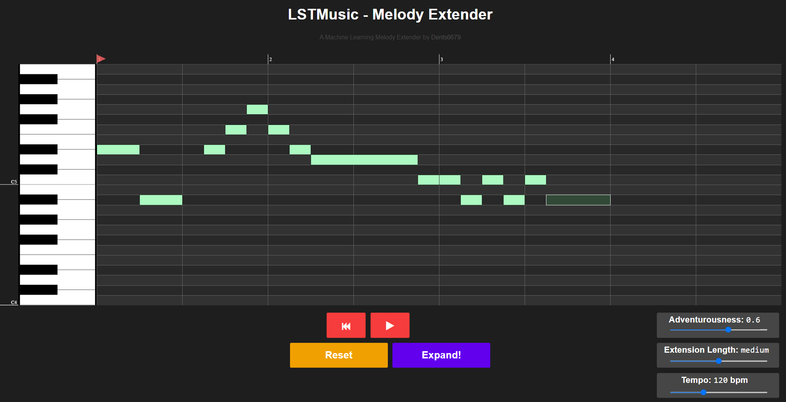
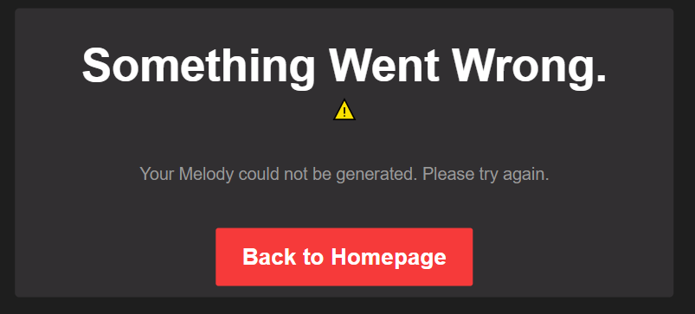
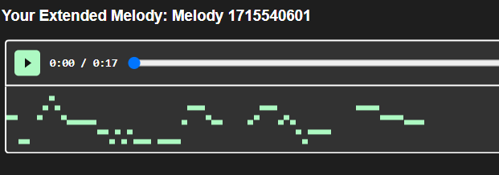
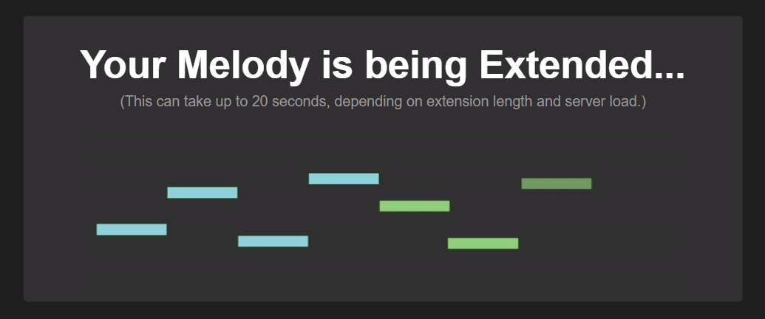
Frontend Prototype 2
Turns out my first frontend prototype wasn’t great…
Replaced piano roll to accept variable note lengths.
Added missing results page functionality.
Plus various other improvements.
Notes:
This led to the beginning of the design and development of my second frontend prototype, which served to essentially remake my entire frontend.
I ended up swapping my piano roll with a custom piano roll element made by someone on github called G200KG, and it immediately had much better usability with custom note durations, more robust playback support and generally felt much cleaner than my implementation.
But this did come with the drawback of needing to spend a few weeks to decode the music format that was used in it, which wasn’t helped by the repositorys mediocre documentation.
The rest of this second prototype was made without many issues, with a custom visualiser being added to the results page, using a custom visualiser element by someone called Cifako on GitHub
An error handling system was also added to this prototype to deal with the any errors, as I found that the model would sometimes just crash when extending melodies.
After all of this, time for the project was quite quickly running out, and I needed to get everything hosted.

Slide 10

Hosting
Frontend hosting was made easy through Github Pages.
Backend Hosting, not so much…
Anaconda’s PythonAnywhere?
Uses a supposedly easy GUI
But Doesn’t support Multithreading! My backend needed it…
AWS LightSail?
No GUI, stuck with Bash.
But better documentation, and multithreading support.
Notes:
Getting everything hosted was a little bit nerve wracking as It was getting to around April at this stage, Hosting my frontend was quite a walk in the park due to GitHub’s pages system, which helpfully hosts static frontend content without any hastle so getting all of that was fine.
But the backend? I originally spent quite a while hastling with Anaconda’s PythonAnywhere platform, I originally chose it due to it having a supposedly user friendly GUI, I had a few issues with dependencies and found its system really outdated meant that I was slowed down.
However, I pushed through all of this and got the flask API running, only to find that this arbitrary rule that anaconda put into pythonanywhere saying that multithreading isn’t allowed, meant that my whole system didn’t work.
My Flask API works by using multithreading , it defers generation requests
I won’t go into the technical content here, it’s in my report, but it meant that my system didn’t expand melodies.
So I had to look elsewhere and ended up needing to set up my own Linux server on amazon lightsail, which was ironically easier than pythonanywhere as Amazon LightSail’s documentation is pretty damn good, you’d hope it is given one of the biggest companies in the world are behind it!
But in the end, I got everything running. I had my project online, leaving a month to spare for a write up.
So let’s have a look!

Slide 11
Demo
https://Dents6679.GitHub.io/LSTMusic

Slide 12
Does the Project do its job?
Participants of my short assessment seem to agree.
Notes:
I guess that leads us with the question of if all of this development succeeded.
All in all I would say that the final product my project completes most of the objectives I set out and does what I intended it to do. User feedback from a short assessment I conducted tending to agree that the system is easy to use, entertaining and pretty much fulfils its purpose as an experimental toy.

Slide 13
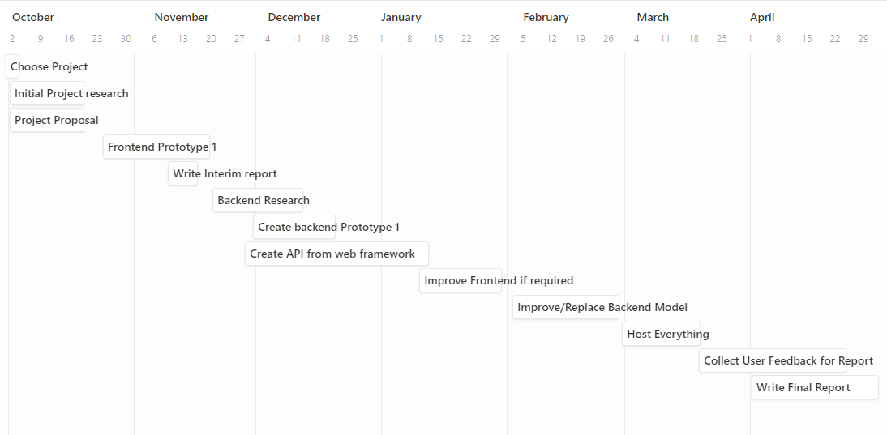
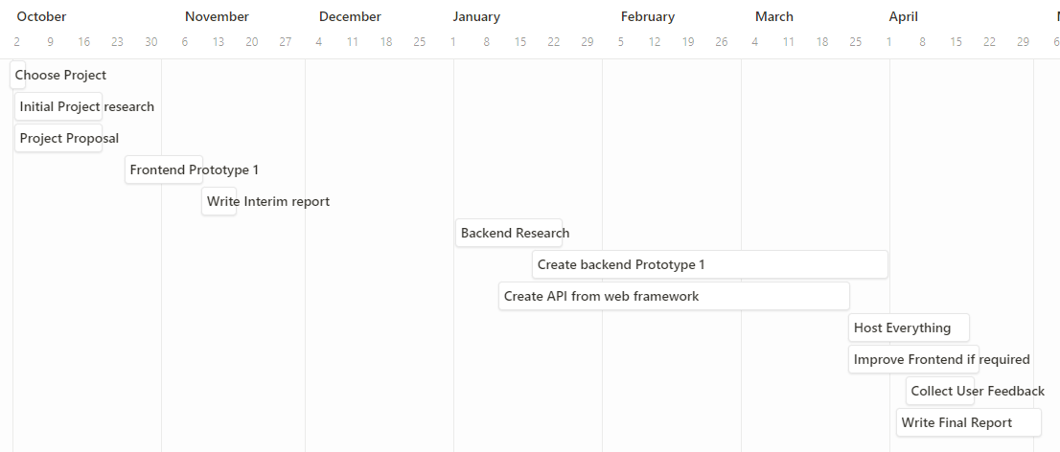
However…
The Music Extension model kind of sucks, and participants agree.
The extension Model was stuck in a prototype stage that I originally aimed to improve.
Unfortunately, my planning was too optimistic.
I ran out of time and couldn’t improve it.
…Resulting in a disappointing model.
Expected project plan
“broke on many occasions”
“Kind of dull, uncreative, seemingly random”
“Music outputted is very short”
Reality, how the project went
Notes:
However, while the interface and overall user experience is might be good, the actual melody extension model used isn’t.
The model that made it into my final product sadly contains several bugs, randomly crashes, and often fails to actually take influence from a user’s melody.
It was a bit of a prototype model that I originally planned to improve or replace after revising my frontend, but time was unfortunately running out and I had the choice to either host the tool online or improve the model used.
I ended up deciding to prioritise getting everything hosted online as this would better align with the overall goal of my project, but at the expense of the model’s quality.
It’s quite clear to me that this was mainly caused due to overly-optimistic planning and an inability to, I suppose, get the ball rolling with backend development in the leadup to the January exam period.
This was pretty much the main downfall of the project and is reflected in the user feedback that I received relating the extension model’s performance.

Slide 14
Still… It’s all there!
Everything is there!
The model just needs improvement…
Modularity makes future work for model swapping easier
Despite the model’s struggles, the project’s objectives were complete and I built the webdev foundation I was looking for!
Notes:
But, at the end of it all, my project was online and could produce slightly musical extensions of provided melodies, although with some inconsistency.
There’s a lot of avenues for further work for this project, and I did background research for some of them. I didn’t have time to go any further with them unfortunately, but the ideas and plans are there in my report
But… as critical as I and other users can be of the generation model itself, my project’s succeeded in creating a platform for a system like Continue, and I was able to get the I was looking for at
the start of the project.

Slide 15
Any Questions?

